Slide 1
Channel Estimation Using Deep learning in Underwater Acoustic Communication Systems
Members
Abhiram 17EC117
Ajay Bingi 17EC210
Sunnyhith Yadlapalli 17EC154
Under the guidance of
B Nagavel Assistant Professor,Nitk

Slide 2
Problem Statement:
Proposing a Deep Learning Model for the accurate Channel estimation In Underwater Acoustic Communication systems
Motivation :
Underwater Acoustic (UWA) communication faces a lot of hurdles such as environmental characteristics, variety of noises, temperature, pressure, salinity, etc which makes the UWA channel unique.

Slide 3
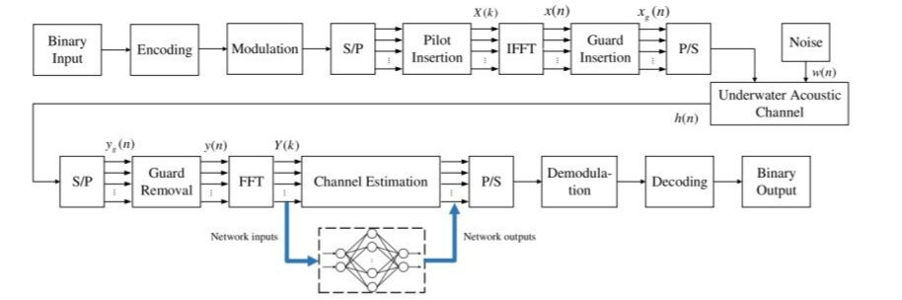
Block diagram of UWA-OFDM system model.

Slide 4
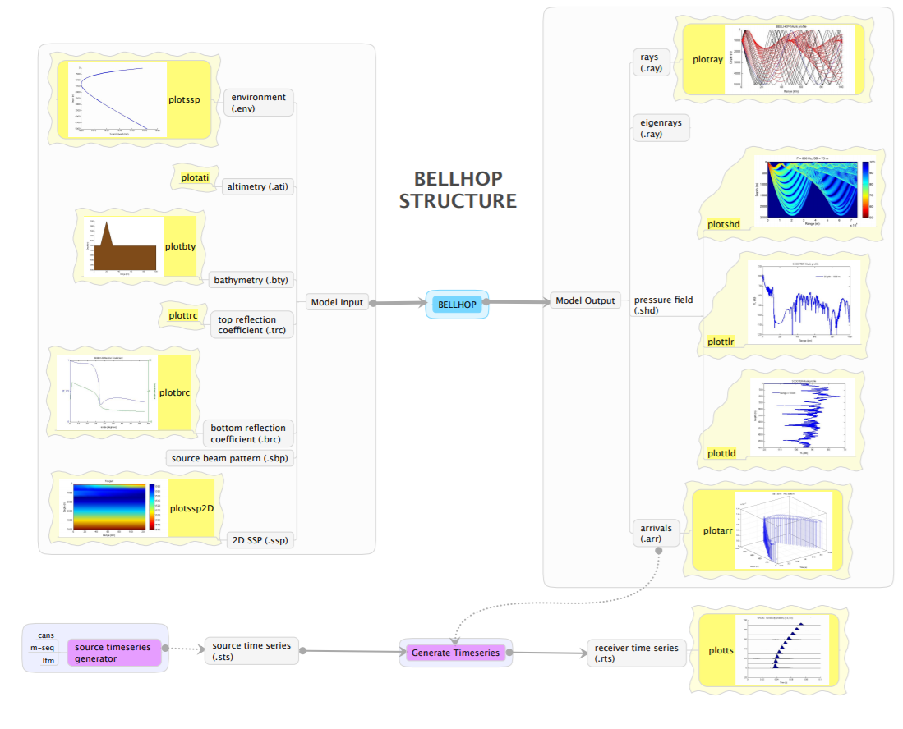
Bellhop Ray Model

Slide 5
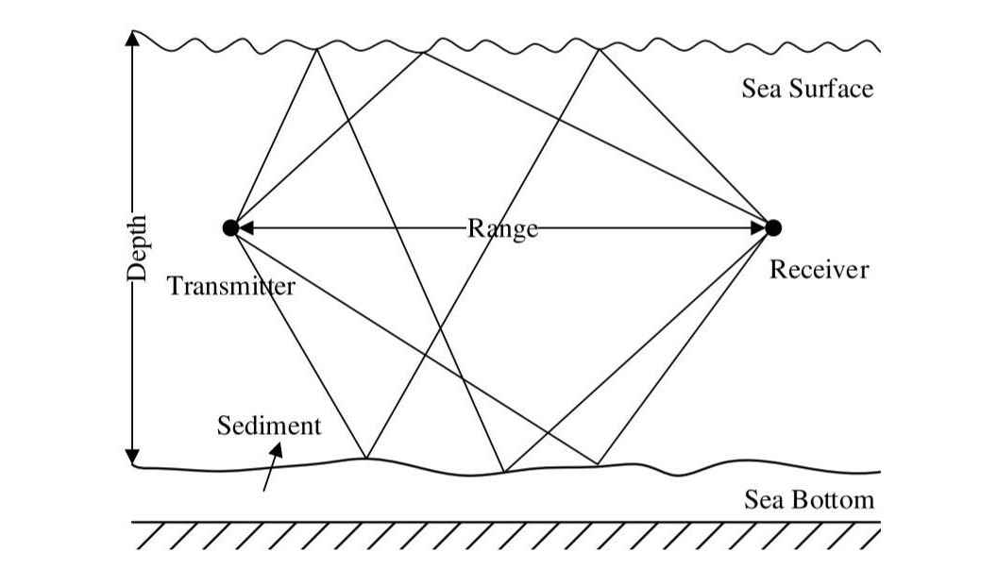
BELLHOP ray model of a shallow UWA multipath channel
Environmental factors including the variation of sound speed at depths, shapes of sea surface and bottom, boundary reflection and scattering, and geometry of the transmitter and receiver are considered in this model.

Slide 6
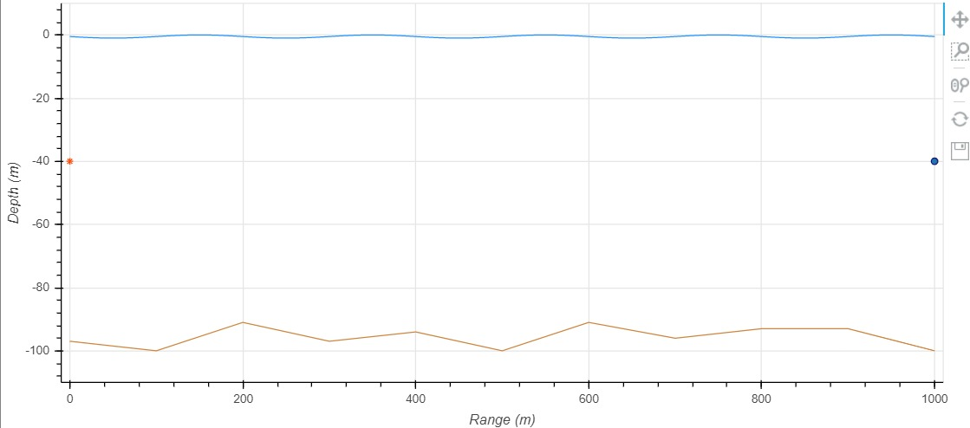
Simulations after using Bellhop Ray Model
Assumed Underwater Environment Model

Slide 7
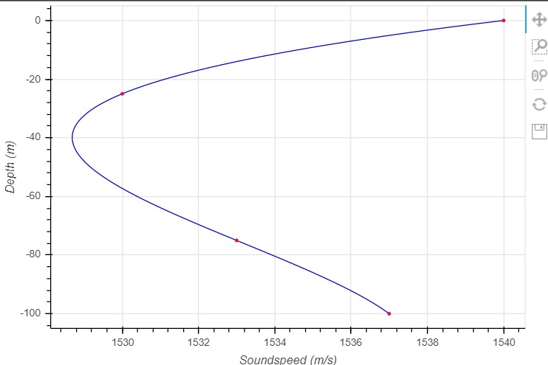
Sound Diagram

Slide 8
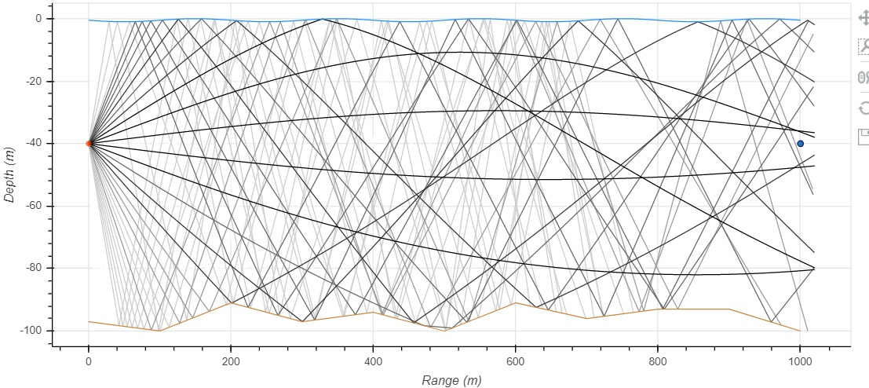
Computed Race Diagram

Slide 9
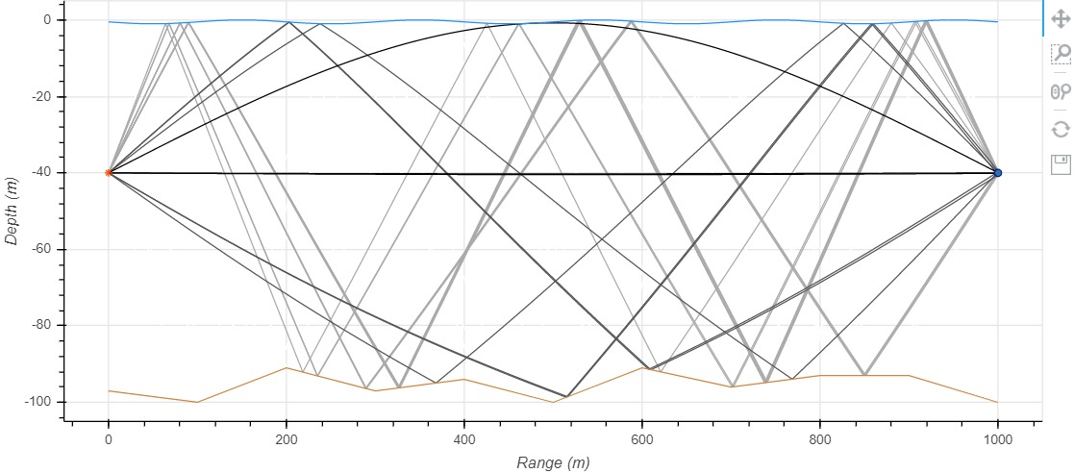
Eigen Rays Diagram

Slide 10
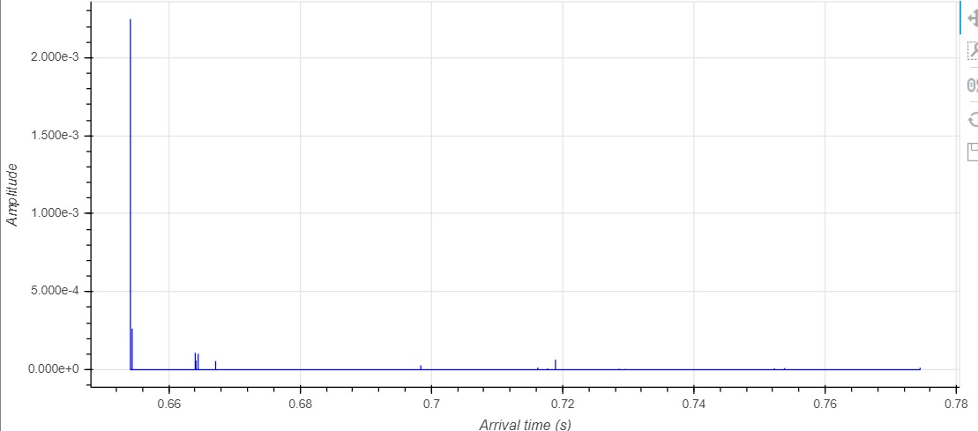
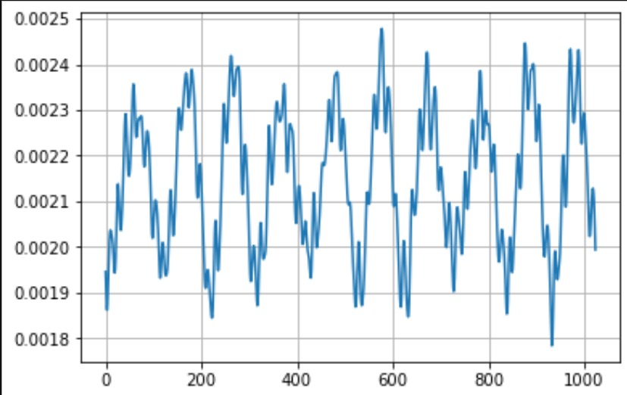
Impulse Response Showing Arrival time Impulse Response in Frequency domain

Slide 11
Block diagram of UWA-OFDM system model.

Slide 12
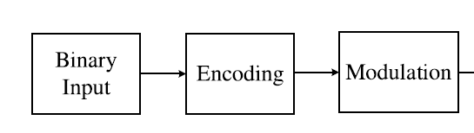
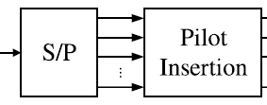
the binary data sequence is firstly encoded and mapped with QAM modulation schemes
The modulated signal is converted from serial to parallel ones
the pilot tones are inserted to estimate the CIR of the channel model.

Slide 13
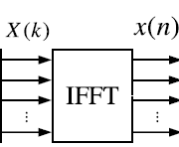
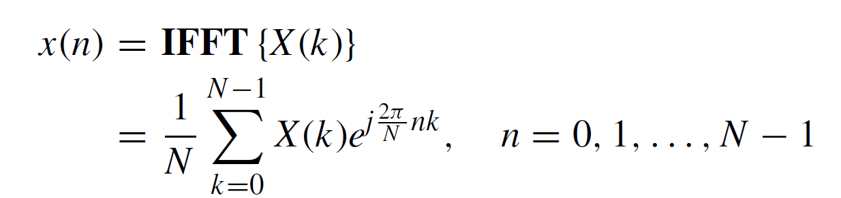
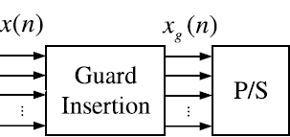
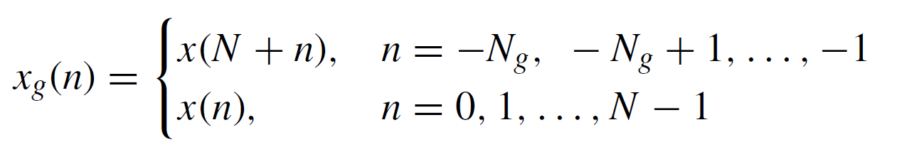
In the UWA-OFDM system, the parallel data are transformed by inverse fast Fourier transform (IFFT) with N orthogonal narrowband subcarriers
The time domain signal x(n) is obtained from the frequency domain signals X(k) as follows:
parallel subcarriers are converted to a serial bitstream and the cyclic prefix samples are inserted as guard intervals to alleviate the ISI
So the time-domain transmitted signal including cyclic prefix can be represented as follows:

Slide 14
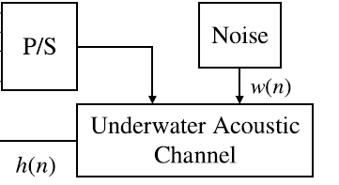
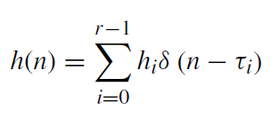
After passing through the underwater acoustic channel, the received signal yg(n) is given by
the operator ⊗ corresponds to the circular convolution and w(n) is the additive white Gaussian noise (AWGN)
h(n) is the channel impulse response that can be represented as follows:

Slide 15
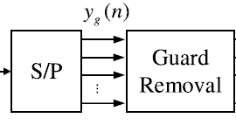
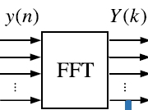
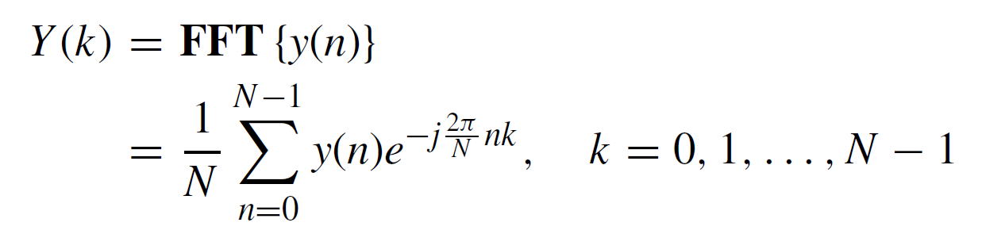
The received signal is split into parallel subcarriers.
Then cyclic prefix is removed out.
The time-domain signal y(n) is transformed to frequency-domain signal Y (k) by FFT
Under the assumption that the ISI is completely eliminated, the received signal can be formulated as:

Slide 16
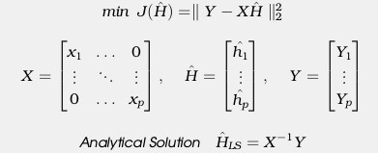
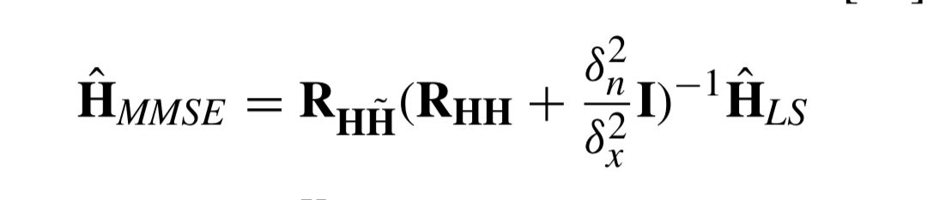
Channel Estimation Methods
Least Square Method
Least Square estimation is the euclidean distance between the received signal and the original signal.
Minimum Mean Square Error Method
Estimates the channel response by applying them to various M-QAM modulations
MMSE channel Estimation is given by

Slide 17
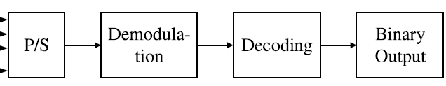
The compensated signal after channel estimation is congregated into a serial sequence
Which is then demodulated and decoded by the corresponding methods in the transmitter.
At this point, the output of UWA-OFDM system model is obtained as the final binary data sequence.

Slide 18
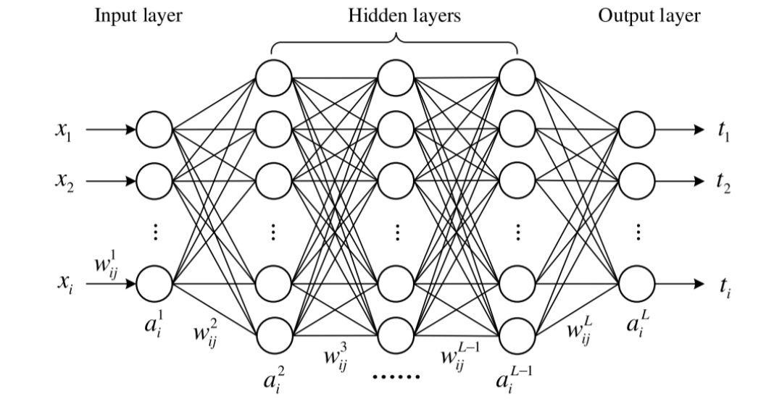
Deep Neural Networks
Typical architecture of deep neural network model
It consists of an input layer, multiple hidden layers, and an output layer
The neurons in the two adjacent layers are fully connected, whereas the neurons in each layer are not connected.

Slide 19
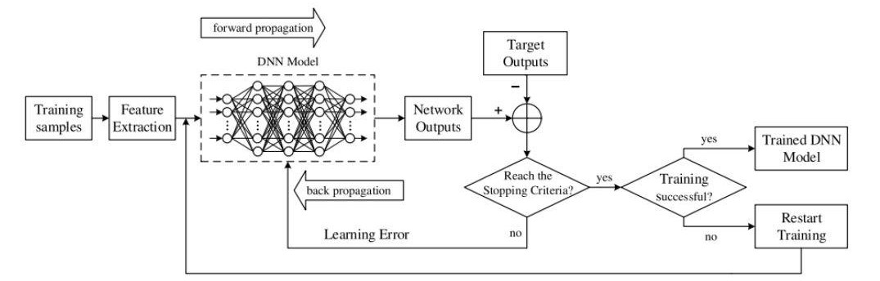
Training process of the proposed DNN models.
The objective of training a DNN is to find the optimal parameters of weights and biases to minimise the error between the network outputs and the target outputs.

Slide 20
Completed Work
We developed OFDMI Model and Bellhop Ray Model for Underground Acoustic environment
Channel Estimation using Least Square method and Minimum Mean Square Error Method
Channel Estimation using deep neural networks
Future Plan
In the coming days we are planning to work on different modulation techniques other than QAM.
We are planning to develop CNN,Encoding and Decoding Architectures for deep neural networks other than fully connected layers.

Slide 21
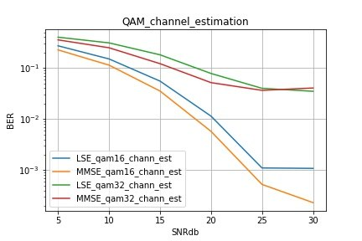
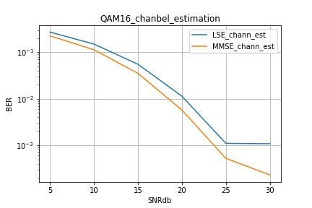
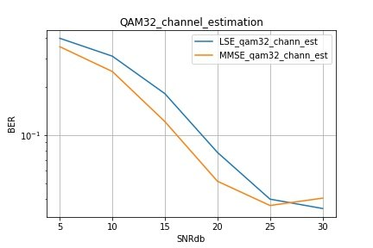
Outcomes

Slide 22
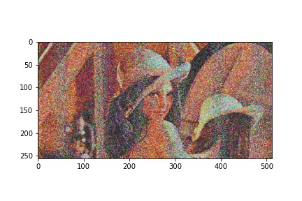
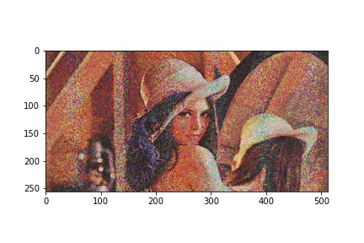
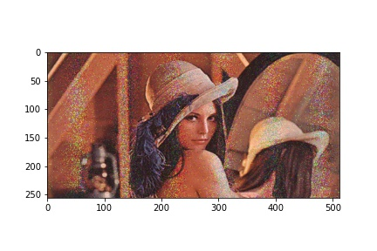

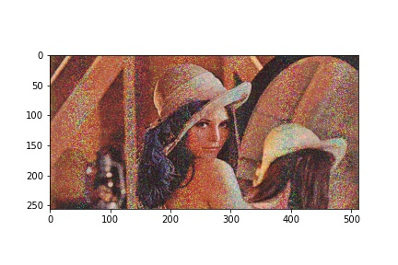
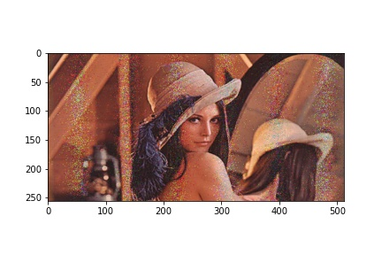
Comparison Between LS and MMSE Methods of channel Estimation
Qam16_LS_snr5 Qam16_LS_snr10 Qam16_LS_snr15
Qam16_MMSE_snr5 Qam16_MMSE_snr10 Qam16_MMSE_snr15

Slide 23
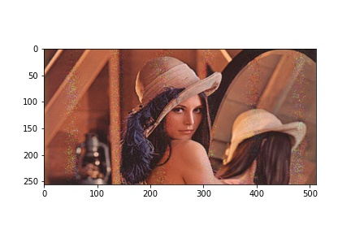
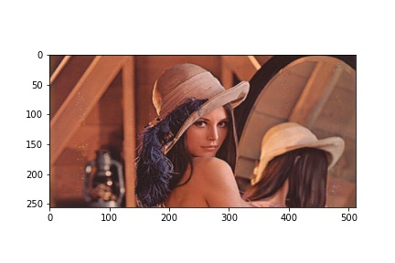



Comparison Between LS and MMSE Methods of channel Estimation
Qam16_LS_snr20 Qam16_LS_snr25 Qam16_LS_snr30
Qam16_MMSE_snr20 Qam16_MMSE_snr25 Qam16_MMSE_snr30

Slide 24
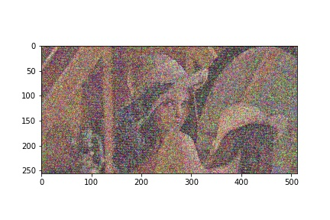
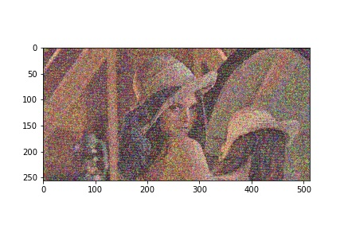
Comparison Between Qam-16 and Qam-32 Modulation
Qam16_LS_snr10 Qam32_LS_snr10
Qam16_MMSE_snr10 Qam32_MMSE_snr10

Slide 25
References
J. Preisig, ‘‘Acoustic propagation considerations for underwater acoustic communications network development,’’ ACM SIGMOBILE Mobile Comput. Commun. Rev., vol. 11, no. 4, pp. 2–10, Oct. 2007.
M. Stojanovic and J. Preisig, ‘‘Underwater acoustic communication channels: Propagation models and statistical characterization,’’ IEEE Commun. Mag., vol. 47, no. 1, pp. 84–89, Jan. 2009.
R. Diamant and L. Lampe, ‘‘Low probability of detection for underwater acoustic communication: A review,’’ IEEE Access, vol. 6, pp. 19099–19112, 2018.
G. Qiao, Z. Babar, L. Ma, S. Liu, and J. Wu, ‘‘MIMO-OFDM underwater acoustic communication systems—A review,’’ Phys. Commun., vol. 23, pp. 56–64, Jun. 2017.
T. Lufen and X. Xu, Digital Underwater Acoustic Communications, 1st ed. New York, NY, USA: Academic, 2017.

